Slide 1
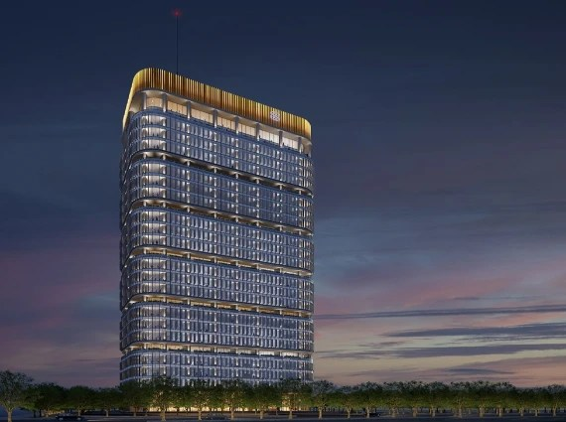
International Financial Services Centre Authority, GIFT City Ministry of Finance, Government of India Gandhinagar, GUJARAT INDIA
Regulatory Overview for Finance Companies and Treasury Centres
07/02/2025

Slide 2
3.1 Global/Regional Corporate Treasury Center (GRCTC) – Framework
Eligibility and Registration
Service Recipient
Registration under Finance Company Regulations*
2 stage process
Provisional Registration
Certificate of Registration
Time: 90 days from receipt of application.
Group entities (GE) of GRCTC
GE of parent of GRCTC
All GE from FATF complaint Jurisdiction.
Tresury activities/ services to India – subject to FEMA
Legal Form
Light Touch Regulation
Company or Branch
Exemption from prudential requirements (CRAR, LC, EC) subject to board approved policies on corporate governance, risk management and meeting fit and proper criteria of Authority
Owned Fund: USD 0.2 mn
Global Treasury Centre
Currency and Transactions
Freely convertible foreign currency transactions (15 currencies specified)
Can carry out transactions in currencies not specified, provided they are settled in specified currency.
Separate INR account for administrative expenses.
Fees
Application: USD 1000
Registration: USD 125000
Recurring: USD 25000

Slide 3
3.2 Permissible Treasury Activities and Treasury Services
01 Borrowing
02 Credit arrangements
03 Transacting/ Investing in financial instruments
Borrow funds/raise debt either in its own account or on behalf of its service recipients.
Intra-company borrowing/deposits.
Lending, providing credit guarantee, performance bonds and any other credit facility.
Includes stocks, shares, bonds, or other financial instrument
04 Derivative transactions
05 Factoring & Forfaiting
06 Re-invoicing
Seek registration as a Factor under IFSCA (Registration of Factors) Regulations, 2024.
Sale and purchase of goods on behalf of service recipients, provided GRCTC does not take physical possession of such goods
Includes OTC/exchange traded derivatives with counterparties/ market-makers.
Counterparty may be inside or outside IFSC

Slide 4
3.2 Permissible activities
07 Liquidity Management
Pooling of Funds
Optimizing commercial cash flows
Managing supplier relationships
09 Others
Maintaining relationships with financial counterparties.
Management of obligations on behalf of service recipients towards insurance and pension related commitment.
Providing advice related to financial management including financial risk management.
Providing Advice related to funding and capital market activities.
08 Act as a Holding Company
Acquisition or investment in group entities by way of equity shares, preference shares, bonds, debentures or loans.

Slide 5
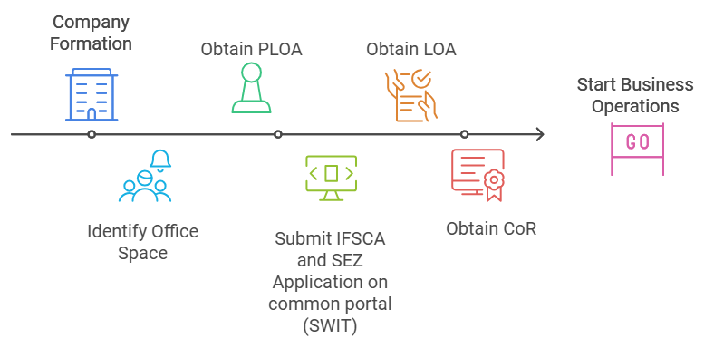
Setting up in IFSC

Slide 6
Potential Benefits for a GRCTC
Consideration for setting up a GRCTC | What’s offered by IFSC
Tax Attractiveness | Income Tax benefit of 10 years out of block of 15 years No GST and no MAT if concessional regime is adopted Provisions of ‘deemed dividend’ shall not apply on any advance or loan between two group entities. (proposed in Finance Bill 2025)
Regulatory Reporting Framework | One single unified regulator Lower regulatory reporting requirements envisaged
Infrastructure & Accessibility | Low cost of operation due to locational advantage Easy accessibility and well connected by all modes of transport
Government Incentives | State government incentives declared over and above tax benefits
Access to Capital Markets | Exchanges like NSE, BSE and SGX are already active in Gift City Additional tie-ups with foreign exchanges in pipeline
Banking Factors & Currency Environment | Many domestic and international banks have already set up or in a process of setting up their presence in IFSC Availability of structured derivative/ banking products are expected
Availability of Skills and Talent Pool | Availability of highly skilled talent pool within India at competitive cost
Ecosystem Advantage | Fast Growing ecosystem: India’s Global Financial Centre Accessible and Progressive Regulator
Centralised Location | Setting up in IFSC can aid in catering to markets in multiple time zones

