Slide 1

RXIL Global IFSC Limited
Trade Finance Opportunities for EXIM Trade
IFSC – International Trade Financing Services (ITFS) Platforms
Feb 7, New Delhi

Slide 2
Problems faced by Exporters
What are the biggest risks the Exporter faces :
  Credit Risk/Payment Default Risk
  Currency Fluctuation Risk
  Country Risk (Political instability, Currency-Control Regime)
Is there a Solution
The best way to solve the above is to encash the receivables immediately after export !
Benefits of Factoring
Improved cash flow: Factoring provides businesses with immediate access to funds, which can be used to reinvest in operations.
No additional debt: Factoring is not a loan, so it doesn't increase a company's debt.
Credit risk protection: Non-recourse factoring protects businesses from bad debts.

Slide 3
Current state of cross-border Factoring in India
Global share (FY 23)
Country/Region | Export Factoring Volume in USD Bn in 2023
Europe | 476
Germany | 112
China | 144
Taiwan | 33
Singapore | 36
Vietnam | 1.2
Chile | 3
Mexico | 1.3
India | 1.1
(Source : FCI 2023 Report)
Total Cross border factoring volume in India: $ 1.1 Bn
Global Cross border factoring volume: $ 720 Bn
India share: 0.15%
Source: World Bank data, FCI, WTO
However, Volume is growing at double digit CAGR.
MSME impact
MSMEs are responsible for ~45% of India’s total exports
MSMEs face perennial challenges linked to inadequate bank financing, longer turnaround and higher cost of financing
Trade Credit are ‘Document-intensive’ - Digital solutions are key for trade and supply chain structures

Slide 4
The Solution – ITFS Platform
ITFS is an electronic platform for facilitating trade financing for exporters and importers by providing access to multiple financiers.
IFSCA launched the ITFS Framework in July 2021, 4 Approvals, Commencement in 2023.
This platform provides liquidity for exporters & importers from global institutions through Factoring, and other trade financing services at competitive cost.
Making GIFT- IFSC a preferred location for international trade financing.
Over 20 International Financers/Factoring Entities have been onboarded.
100+ Number of Indian Exporters are onboarded for availing finance through ITFS.

Slide 5
List of Products on ITFS Platform
1 | Export Factoring (with Recourse)
2 | Export Factoring (limited Recourse)
 | 2.1 Export Factoring – Correspondent Factor
 | 2.2 Export Factoring – Credit Insurance
 | 2.3 Export Factoring – Bank’s Internal Lines
3 | Import Factoring (Importer in India)
 | 3.1 Import Factoring – based on internal credit lines
4 | Pre-shipment Financing & Supply Chain Financing Solutions
 | 4.1 Pre-shipment Financing
 | 4.2 Export Bill Discounting under Letter of Credit

Slide 6










RXIL Group: Business Activities in India and IFSC
Innovators
TReDS: ₹ 150,000+ Cr Factored, 36,000+ MSMEs
ITFS: Gone Live in Aug-23
TCI: Trade Credit Insurance on TReDS Platform
Hosted G20 Delegates at RXIL office
TReDS
Pioneer in the industry being the first entity to get RBI License and going live for non-recourse receivables financing for MSMEs.
International Trade Financing Services (ITFS)
Policy Enablers
Factoring Policy changes
Participant in RAMP Programme
Workshop with DGFT
Export and Import trade financing requirements, for Indian and Global participants, Exporters, Importers
G20 Participant
Fintech
Capacity Building
Working closely with various stakeholders
RBI | DGFT | DFS |MSME Dept. | State Govts. | Export Councils
One stop solution for corporates to cater to their diverse Supply Chain needs

Slide 7




Journey in GIFT City
Oct 1, 2021: ’In-principle’ approval from IFSCA
Jul 26. 2022: RXIL Global IFSC Limited was setup
Nov 18, 2022: Certificate of Registration for ITFS
Jul 13, 2023: Approval for Commercial Go-Live
Aug 9, 2023: Commencement of 1st transaction

Slide 8
ITFS – Transaction Structure

Slide 9





RXIL’s approach to enable Financing on ITFS platform
List of activities to be undertaken by the ITFS platform
KYC/AML/
Sanction Checks
Collection Service *
Import
Factor
PO
Verification
Credit Information
Bureau
Import
Factor
Credit Information
Bureau
E- Bill of
Landing
Vessel
Tracking
Credit Information
Bureau
Sales Ledger
Analysis
Nostro
A/c
Credit
Insurance
ITFS Platform
Dedupe
Check
Import
Factor
Sales Ledger
Analysis
PO
Verification
Nostro
A/c
KYC/AML/
Sanction Checks
Credit
Insurance
`
Dedupe
Check
Vessel
Tracking
Vessel
Tracking
Credit
Insurance
E- Bill of
Lading *
Vessel
Tracking
Dedupe
Check
Sales Ledger
Analysis
E- Bill of
Landing
Sales Ledger
Analysis
Dedupe
Check *
E- Bill of
Lading
Import
Factor
Credit Information
Bureau
PO
Verification
Credit
Insurance
* Currently under development

Slide 10
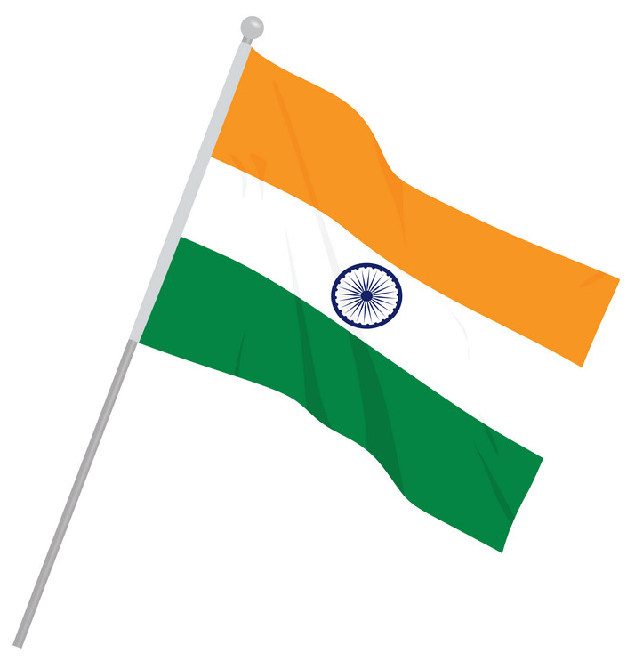





ITFS: Transaction structure 1 (Exports from India)
Shipment
1
Indian Corporate
Importer
Financing Transaction
3
Financier
Repayment Transaction
4
2
Credit Insurance
Premium Payment
^Limits via Insurance arrangement.
Intimation of assignment to the participants
Credit Cover
Process Flow

Slide 11

ITFS: Transaction structure 2 (Imports into India)
Shipment
1
Overseas Corporate
Indian importer
Financing Transaction
3
Financier
Repayment Transaction
4
2
Credit Insurance
Premium Payment
^Limits via Insurance arrangement.
Intimation of assignment to the participants
Credit Cover
Process Flow

Slide 12


ITFS: Transaction structure 3 (Foreign subsidiary)
Shipment
Foreign Subsidiary
Importer
1
Financing Transaction
Repayment Transaction
3
4
Financier
Indian Corporate
2
Credit Insurance
Premium Payment
Credit Cover
^Limits via Insurance arrangement.
Intimation of assignment to the participants
Process Flow

Slide 13
Thank You

