Slide 1
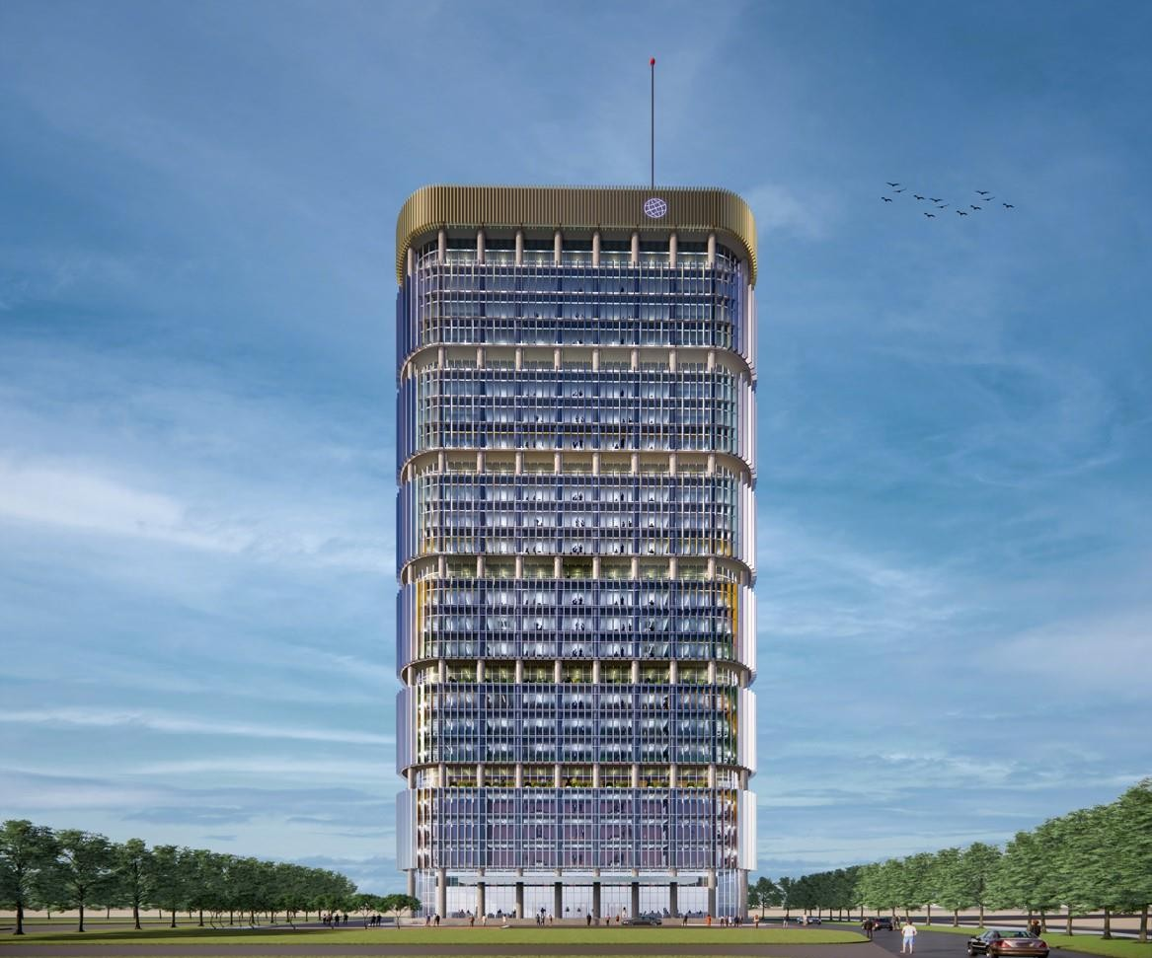


Ancillary Services@ GIFT IFSC - India’s Maiden International Financial Centre
International Financial Services Centres Authority
Ministry of Finance, Government of India GIFT City, Gujarat, India
www.ifsca.gov.in
1

Slide 2

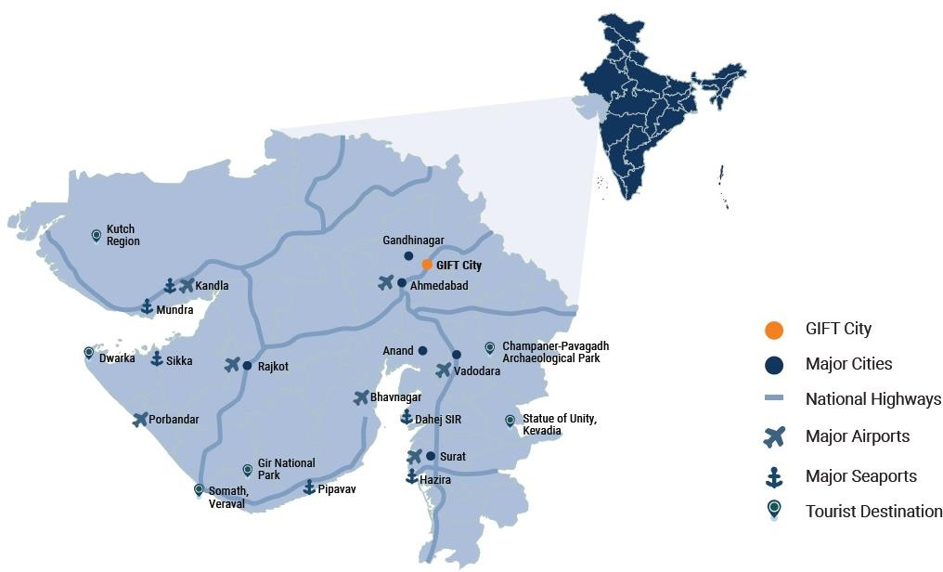
The New India
Land of unlimited opportunities
India is one of the fastest growing major economies in the world and has emerged as the 5th largest economy on nominal GDP terms
India’s total stock market capitalization is approximately USD
3.6 Tn, making it the fifth largest in the world.
India is expected to have 600 Mn Urban population by 2030
India recorded 624 Mn Internet users in January 2021
India attracted highest ever total FDI inflow of USD 82 Bn
during FY-21
At 63rd position, India jumped 79 position in Ease of Doing Business between 2014-19

Slide 3
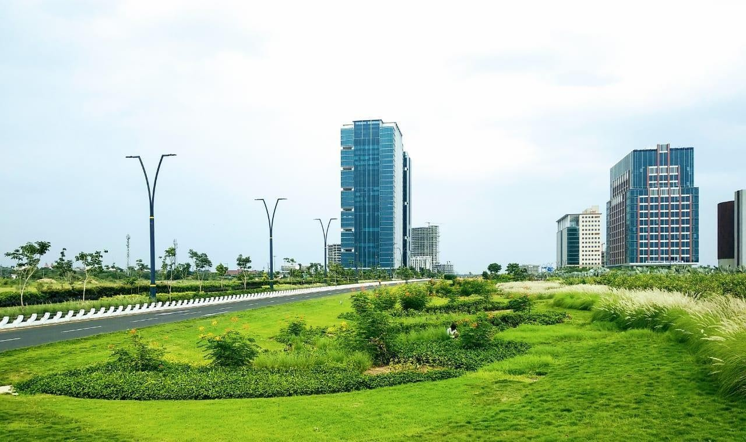
GIFT City –
Overview
A Greenfield Smart City
with State-of-the-Art Infrastructure
A Global Financial & IT Hub
with a Domestic Tariff Area & a Mult- Services SEZ
GIFT SEZ notified as India’s 1st International Financial Services Centre (IFSC)
Strategically located between Ahmedabad and
Gandhinagar
Spead across 886 Acres (being expanded to 3300 acres)
A Vertical City
1st of its kind in the country in scale, scope & quality

Slide 4


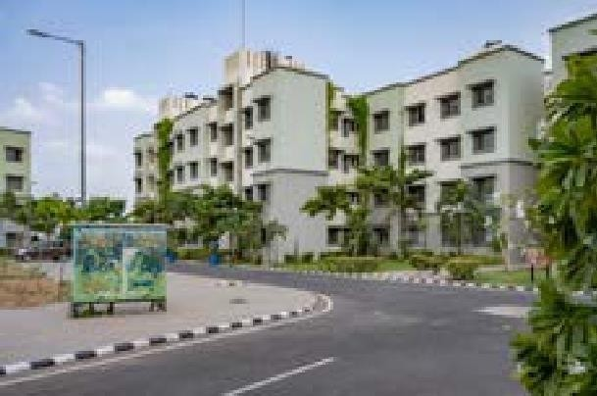
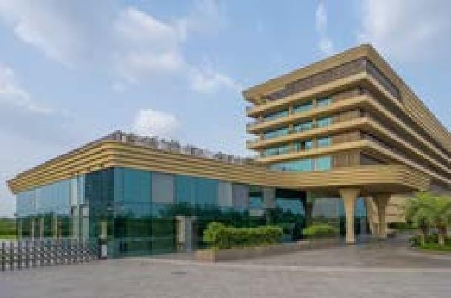
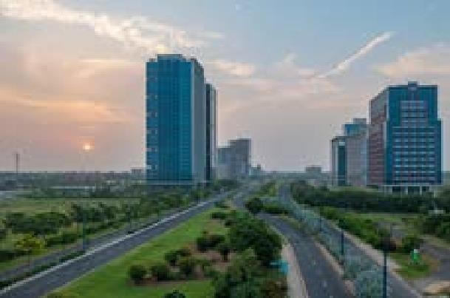
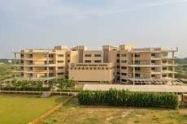
INTEGRATED DEVELOPMENT
COMMERCIAL
BUSINESS DISTRICT
TECHNOLOGY
Smart & Intelligent offices
High-rise business district
Landmark building
Broadband FTTP
Shared IT services
Global connectivity
DEDICATED RESIDENTIAL ZONE
RETAIL CUM ENTERTAINMENT HUBS
Well planned residential areas
Walk-to-work
Affordable housing
High quality entertainment and recreational areas
Smart retail spaces, Restaurants and Sports areas
MOBILITY
SOCIAL
INFRASTRUCTURE
External Connectivity includes MRTS
/ Roads
Efficient Public - Private Transportation
Dedicated Pedestrian Walkways
Dedicated Multilevel Parking
Educational Institutes
International & Domestic Schools
State-of-the-art healthcare
Universities / Training schools
3

Slide 5
IFSC COMPETITIVE TAX REGIME
100% Corporate Tax Exemption (for 10 out of 15 years)
0% Minimum Alternate Tax (MAT)**
0% Capital Gain Tax*
0% Securities Transaction Tas (STT) / Commodities Transaction Tax (CTT)
0% Stamp Duty 0% GST
*On specified securities transferred on recognized stock exchanges in IFSC
**Concessional Rate of MAT applicable for the IFSC units at 9%, however MAT provision not applicable for
companies opting for concessional tax rate under Sec. 115 BAA of the Income Tax Act, 1961

Slide 6







Ancillary Services Providers
Ancillary services covers those services which directly or indirectly aid, help, assist or strengthen or are attendant
upon or connected to activities in relation to financial products, financial services and financial institutions.
More than 90+ Service providers in currently registered with IFSCA Some of the Key Ancillary Service Providers in GIFT IFSC

Slide 7
Ancillary Service Providers in IFSC: Salient Features
Mode of conduct of business
  The entity may be set up in the IFSC in the form of a company or a limited liability partnership or a registered partnership firm, their branch thereof or any other form as may be approved by the IFSCA
Permissible activities
Legal, Compliance and Secretarial
Auditing Services
Professional & Management Consulting services
Administration, Assets Management Support Services and Trusteeship Services
Currency
  The entity can deal in any freely convertible foreign currency as specified by IFSCA
  The entity is permitted to defray its administrative expenses in INR.
https://ifsca.gov.in/Document/Legal/final-circular-on-framework-for-ancillary-services-at-ifscs10022021095756.pdf

Slide 8
Process flow for setting up of an
Ancillary Services Unit
Initial interaction with Department of development to present business case, if found suitable the application is referred to Division of Ancillary Services
Designated officer will interact with Entity to examine business case and provide further guidance
Submission of application for SEZ
approval
Submission of registration application to IFSCA
Grant of Provisional Letter of Approval (PLoA) by SEZ division
Grant of In-principle approval by IFSCA (after grant PLoA from SEZ Division)
Grant of Letter of Approval (LoA) by SEZ Division
Grant of final Letter of Authorization by IFSCA (after grant of LoA from SEZ Division)
Commencement of business by Ancillary Services unit

Slide 9
Key opportunities for Ancillary Service providers in IFSC
Low Operating cost
Availability of skilled talent in field of finance, accounting fund administration, etc.
Access to international markets
Connecting ~30 Mn strong Indian diaspora which has a combined net worth of ~USD 3 Tr to India through IFSC
Inbound and outbound gateway for International Financial Services
State of art physical and social infrastructure
Emerging as a leading hub for Professional Services
Robust air, road and rail connectivity

Slide 10
THANK YOU

